Slide 1

Project Title - Seasonal Agriculture Performance Analysis
Student Name : Syeda Tahoora Fatima
College Name- Stanley College of Engineering &Technology for Women
AICTE STU ID : STU6808dec0f2ad91745411776

Slide 2

PROBLEM STATEMENT
Agricultural activities are influenced by seasonal variations in environmental conditions, farming practices, resource availability and market conditions. As a result, agricultural performance may differ from one season to another.
However, raw agricultural data does not clearly explain how agricultural performance changes across seasons or what patterns can be observed in different seasonal conditions.
The problem is to analyze the given agricultural dataset and investigate seasonal differences in agricultural performance by identifying meaningful patterns, trends, relationships and variations within the available data.

Slide 3
Project Description
Seasonal Agriculture Performance Analysis is a data analysis project that examines agricultural performance across different seasons, crops, regions, and farming conditions. The project analyzes factors such as rainfall, temperature, soil conditions, resource usage, irrigation, crop yield, production, water efficiency, disease/pest risk, revenue, and profit.
The analysis uses data cleaning, exploratory data analysis, statistical analysis, and visualization techniques to identify seasonal patterns, compare agricultural performance, and understand differences across crops and regions. The findings help identify high-performing seasons, resource-use patterns, economic differences, and areas where better seasonal agricultural planning can be considered.

Slide 4

WHO ARE THE END USERS?
End Users:
Farmers and farm managers
Agricultural planners and consultants
Agricultural researchers
Government and agricultural departments
Agribusinesses

Slide 5

Technology Used
Python – Programming and data analysis
Google Colab – Development and execution environment
Pandas – Data cleaning and data manipulation
NumPy – Numerical computations
Matplotlib – Data visualization
Seaborn – Statistical visualizations and charts
SciPy – Statistical tests such as ANOVA and Kruskal-Wallis
CSV Dataset – Data source

Slide 6
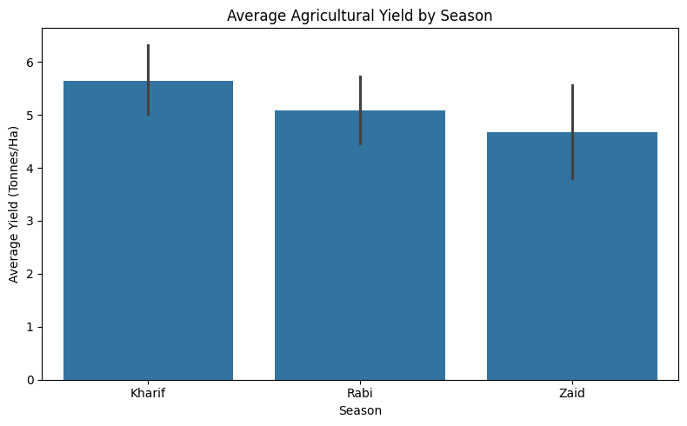
RESULTS
Seasonal Analysis: Yield By Season
Plot: Bar chart Use: Season vs Yield_Tonnes_Ha
results:
Kharif → 5.64 t/ha
Rabi → 5.08 t/ha
Zaid → 4.67 t/ha
Interpretation: The average yield is highest during the Kharif season at 5.64 tonnes/ha, followed by Rabi at 5.08 tonnes/ha. Zaid has the lowest average yield at 4.67 tonnes/ha. This indicates that agricultural yield varies across seasons, with Kharif showing the strongest overall performance.

Slide 7
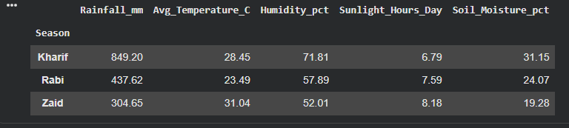
RESULTS
Environmental Analysis : Season vs Environmental Conditions
Interpretation: Kharif receives substantially higher rainfall and has higher humidity and soil moisture. Rabi has the lowest average temperature, while Zaid has the highest temperature and sunlight but the lowest rainfall, humidity and soil moisture. These results demonstrate clear differences in environmental conditions across seasons.

Slide 8
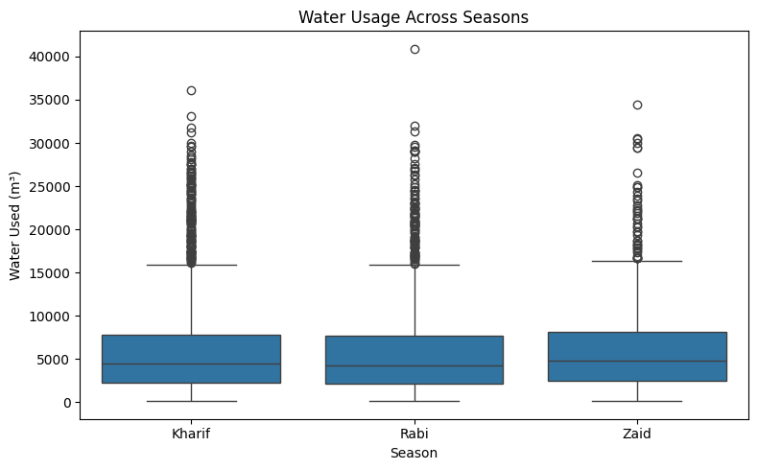
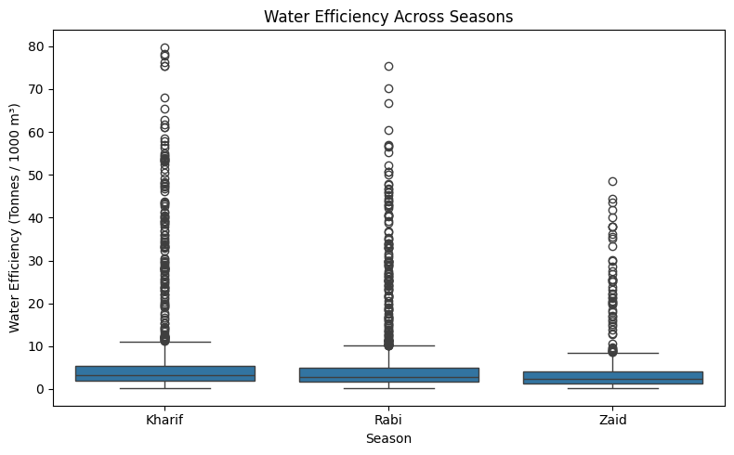
RESULTS
Resource Analysis: Water Usage Vs Water Efficiency
Interpretation: Zaid uses the highest average amount of water at 6,419.89 m³ but has the lowest water efficiency at 4.41 tonnes per 1,000 m³. In contrast, Kharif has higher water efficiency at 5.89 tonnes per 1,000 m³. This indicates that water management is particularly important during the Zaid season.

Slide 9
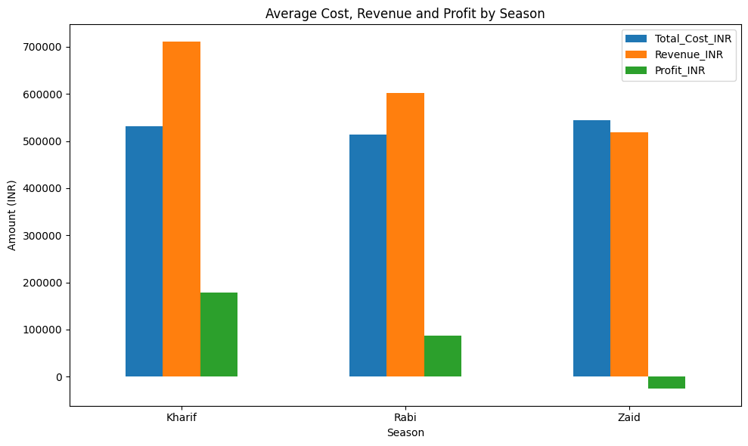
RESULTS
Economic Analysis : Average Cost, Revenue and Profit by Season
Interpretation:
Kharif is the most profitable season: Highest revenue (over ₹7L) and maximum profit margin due to optimal monsoon conditions.
Rabi shows stable but lower returns: Costs stay flat, but lower seasonal revenues cut total profits in half compared to Kharif.
Zaid operates at a net financial loss: Dry summer conditions force the highest input costs (irrigation) while yielding the lowest revenue, pulling profits below zero (-₹24.8K).

Slide 10
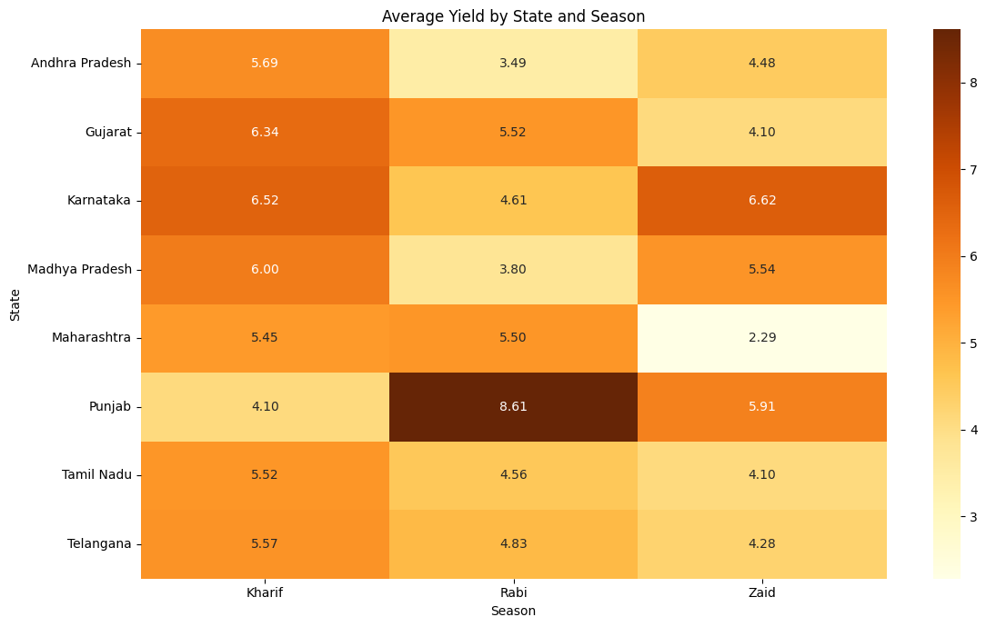
RESULTS
Region(state) x Season Analysis
Interpretation:
The heat map shows that seasonal performance differs across states. Although Kharif has the highest overall average yield, this pattern is not consistent for every state. Punjab performs particularly well during Rabi, with an average yield of 8.61 tonnes/ha, while Karnataka records slightly higher yield in Zaid than Kharif. This indicates that regional conditions influence seasonal agricultural performance.

Slide 11
Future scope
Predictive Analysis: Develop models to predict crop yield and profitability for different seasons.
Weather Integration: Include real-time weather and climate data for better seasonal predictions.
Crop Recommendation: Build a system that recommends suitable crops based on season, soil, rainfall, and temperature.
Resource Optimization: Recommend efficient use of water, fertilizer, and pesticides.
Regional Planning: Provide region-specific recommendations based on state and district performance.
Early Risk Detection: Develop models to predict disease/pest risks and identify unusual seasonal patterns.
Interactive Dashboard: Create a dashboard using tools such as Power BI or Tableau for real-time monitoring and decision-making.

Slide 12
GitHub Link
GitHub Repo Link:
https://github.com/tahoora27/Seasonal-Agricultural-Performance-Analysis-/blob/main/Seasonal__Agricultural_performance_Analysis.ipynb

Slide 13

VOIS Course completion certificate - Course name- Data Visualization

Slide 14
Thank you
.
.

